Slide 1

Hazelcast

Slide 2
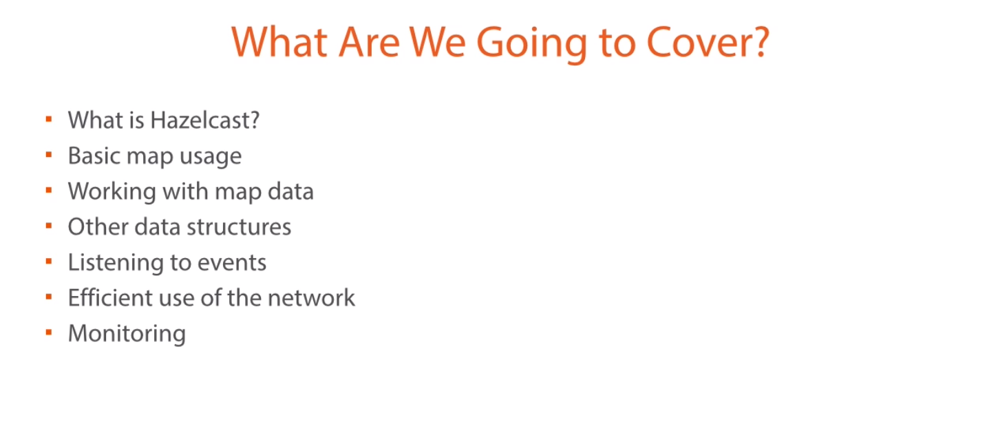

Slide 3
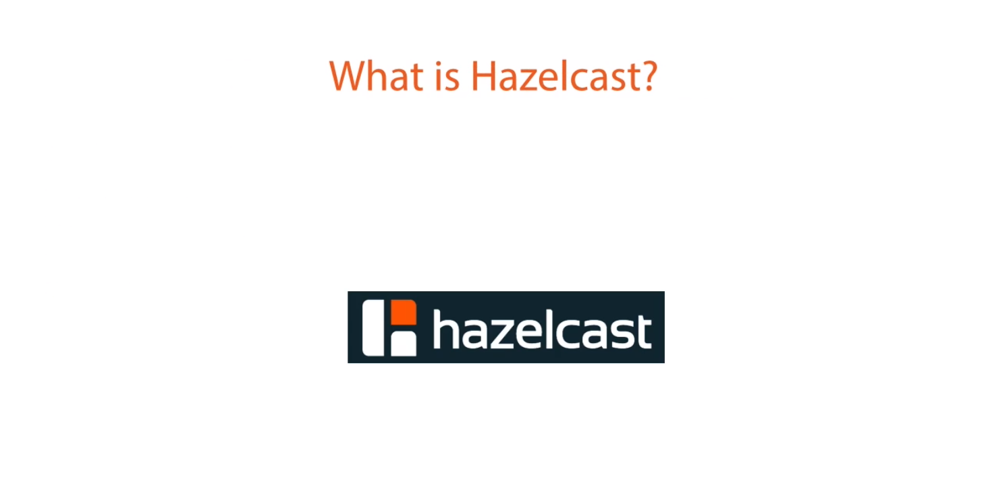
Understanding concept
time-to-live or write through

Slide 4
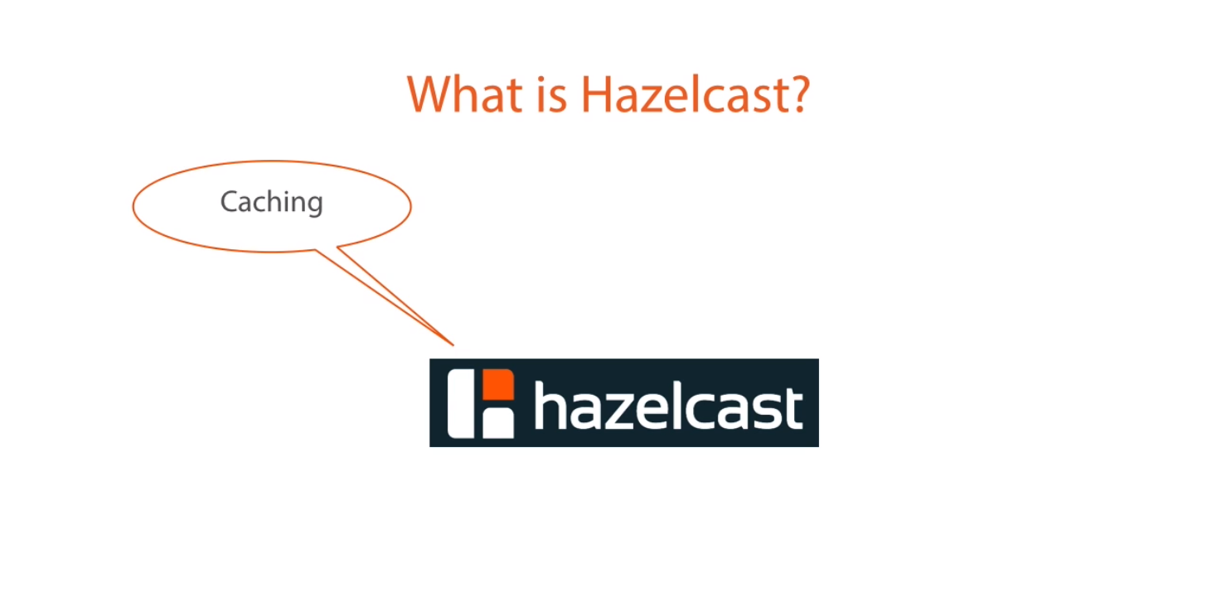
Caching - It's a caching technology that is a distributed cash. Every client has access to cache data no matter where they reside could be on different server or different rack on a data centre or different data centre somewhere else in the country.

Slide 5
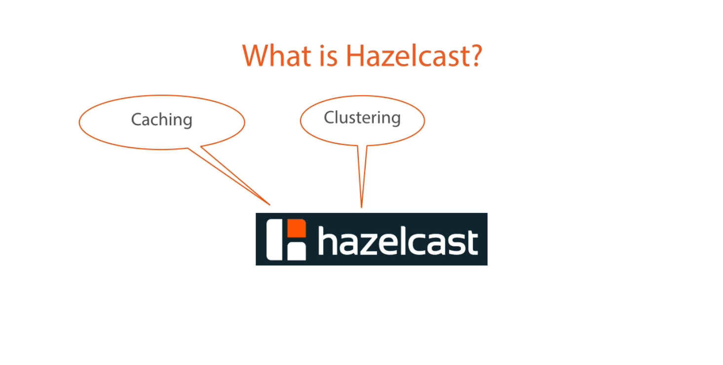
Clustering - We can easily scale out to meet the requirement by starting of additional node which automatically join the cluster.

Slide 6
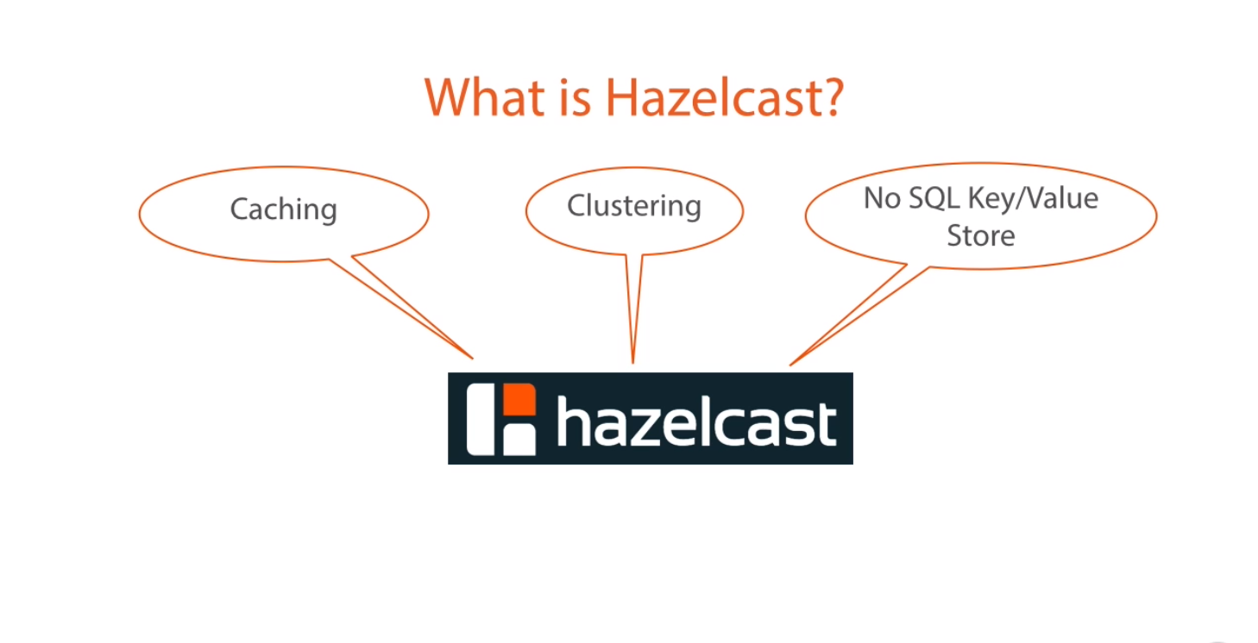
No SQL Key/Value Store - Hazelcast can be uses as a no SQL key value data stores. Because all the data generally store in memory rather the disc is extremely fast.

Slide 7
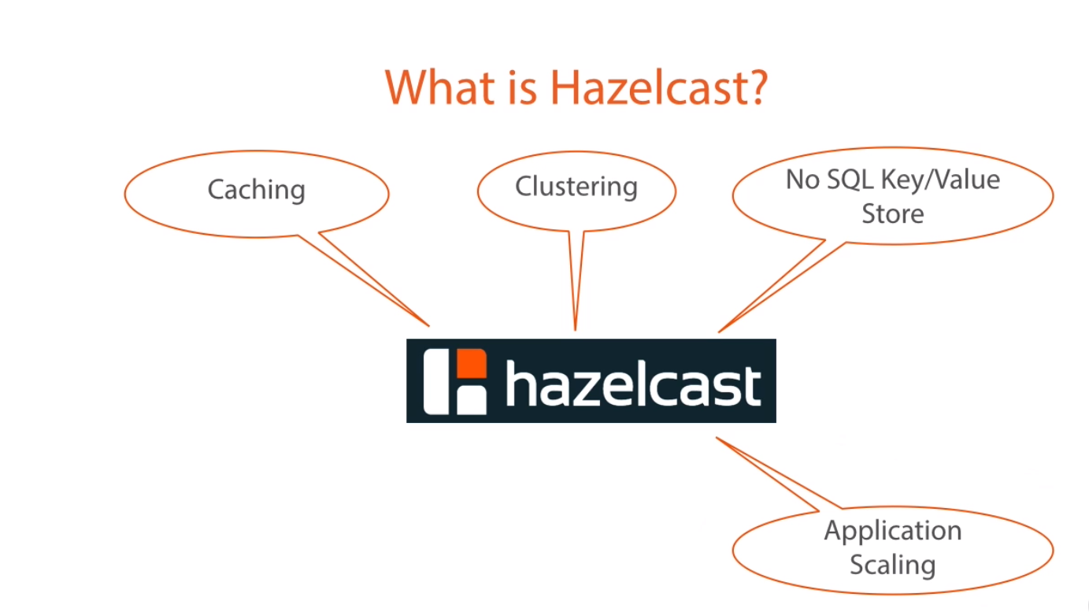
Application Scaling - Hazelcast allow us to easily scale out application by adding new nodes. The new nodes are the memory and see if few resources are available to them to the culture for utilization.

Slide 8
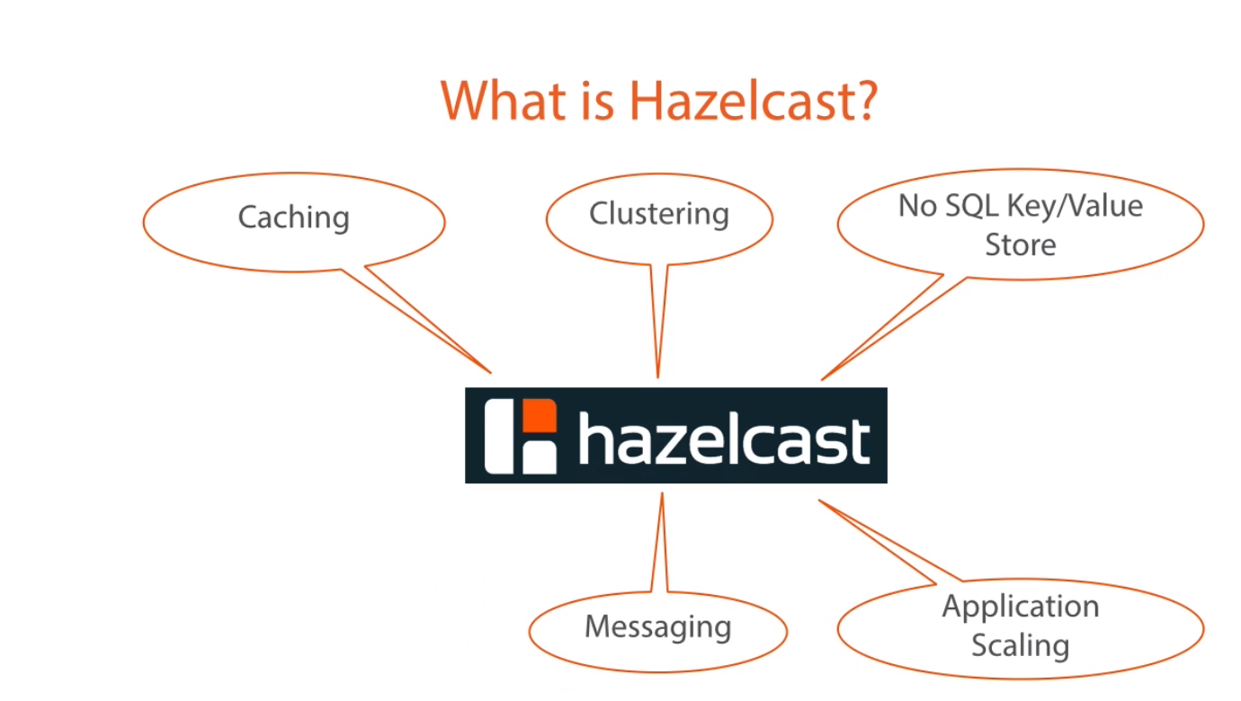
Messaging - Hazelcast has a messaging system built in to it. which support publish/subscrib or produce/consumer model.

Slide 9
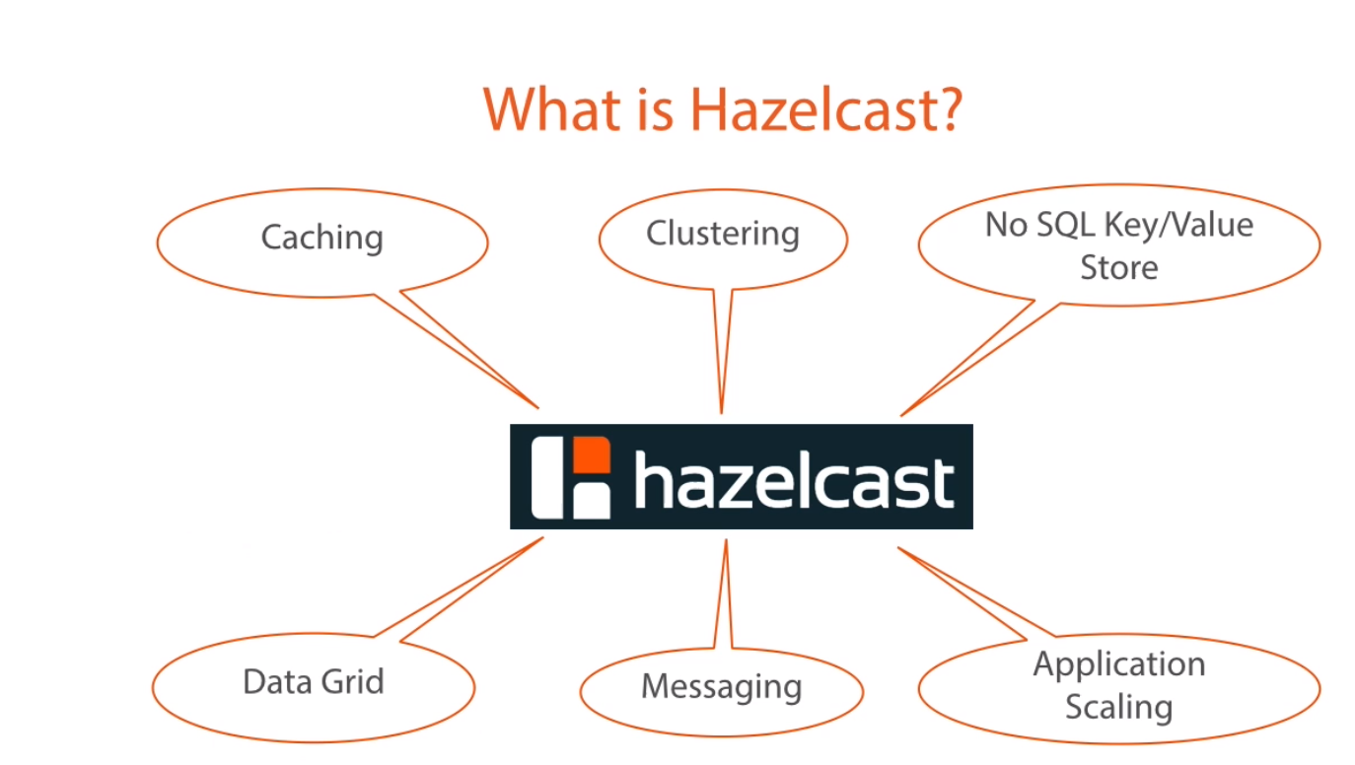
Data Grid - All these features put together making use whole as data grid. This is what allow us to create dynamic first scalable and highly available performed application

Slide 10
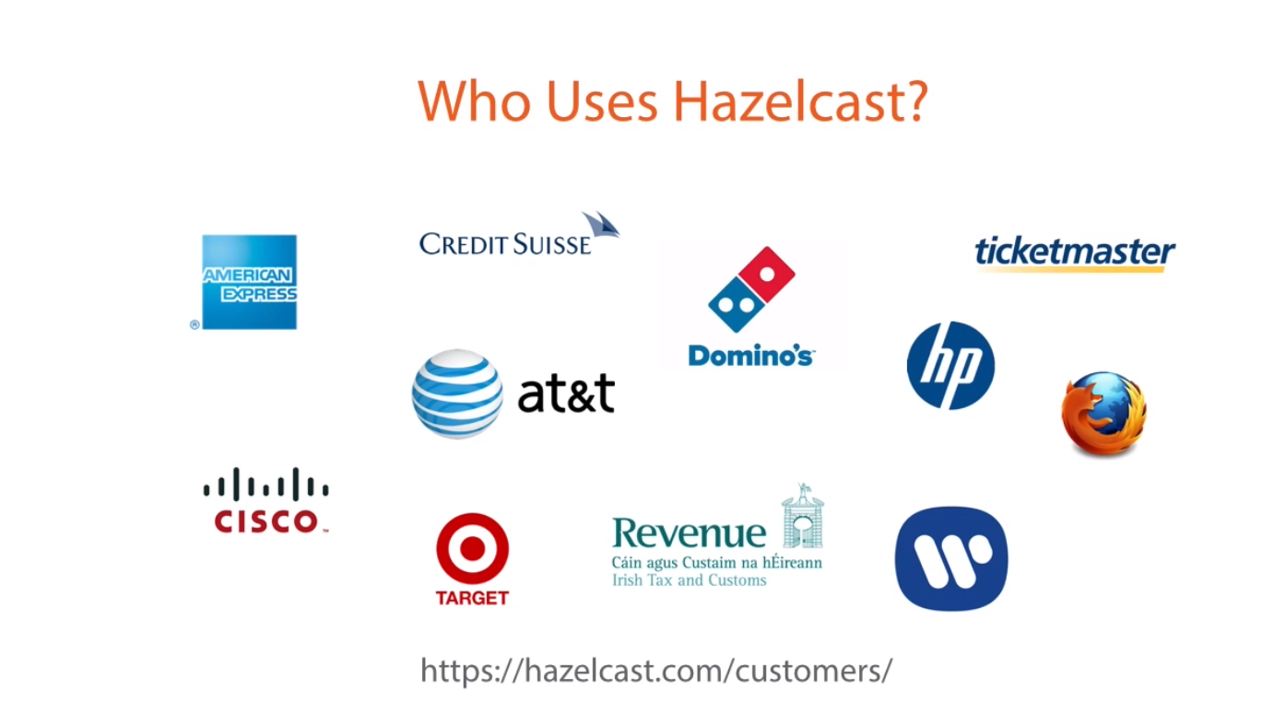

Slide 11
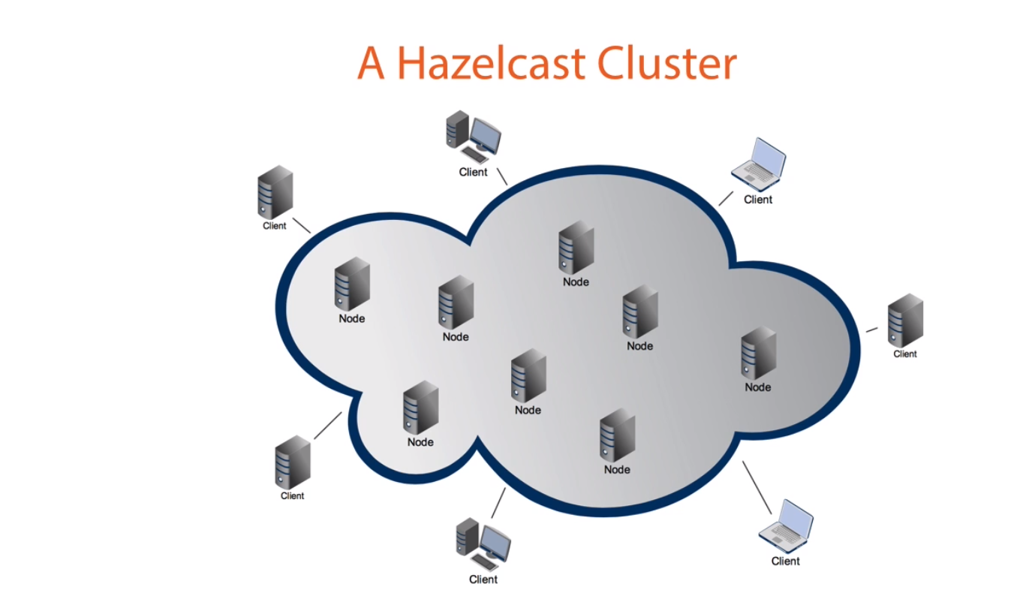
Client is not member of cluster.

Slide 12
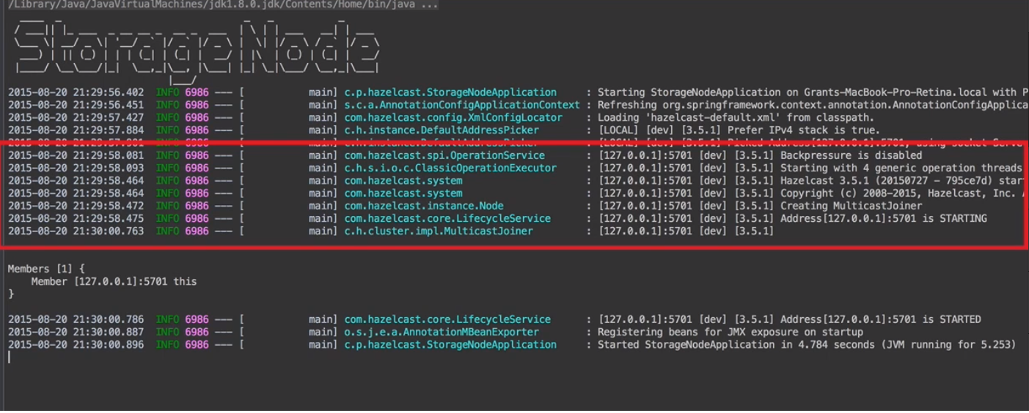

Slide 13

How do members discover each other?
When a member is started in a cluster, it will dynamically and
automatically be discovered.
There are four types of discovery:
Multicast discovery: members in a cluster discover each other by multicast, by default.
Discovery by TCP/IP: the first member created in the cluster (leader) will form a list of IP addresses of other joining members and will send this list to these members, so the members will know each other.
If your application is placed on Amazon EC2, Hazelcast has an automatic discovery mechanism. You will give your Amazon credentials and the joining member will be discovered automatically. Once members are discovered, all the communication between them will be via TCP/IP.
Hazelcast members and native clients support jclouds® for discovery. It is useful when you do not want to provide, or you cannot provide the list of possible IP addresses on various cloud providers. This discovery feature is provided as a Hazelcast plugin.

Slide 14
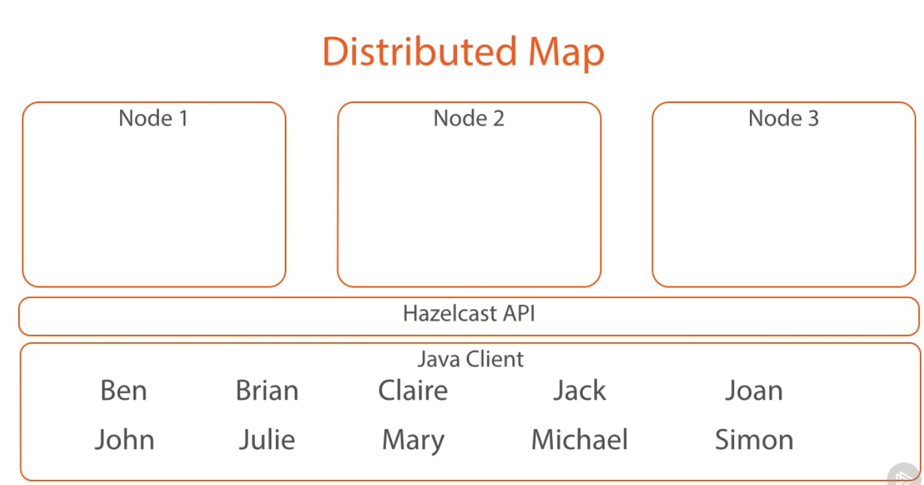

Slide 15
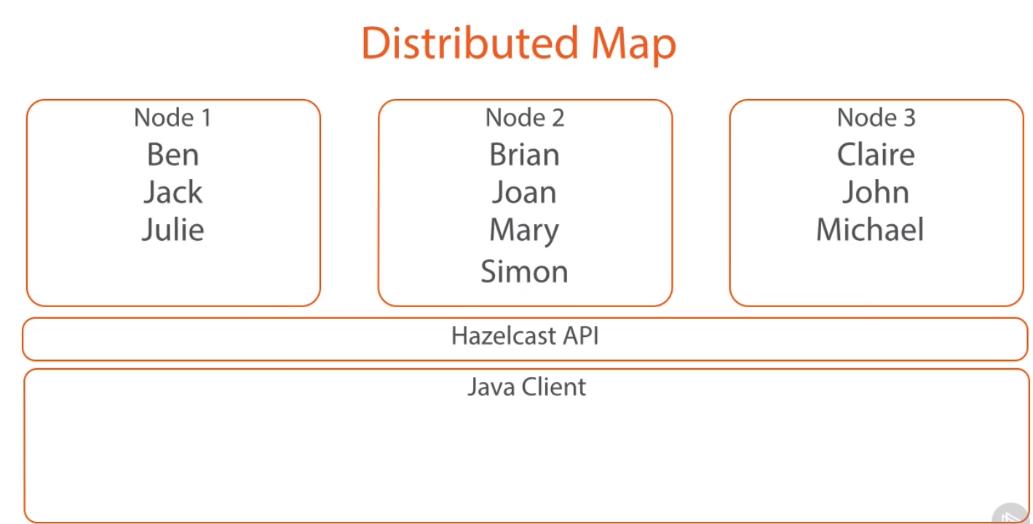
It’s a map with the data contains is distributed across cluster member

Slide 16
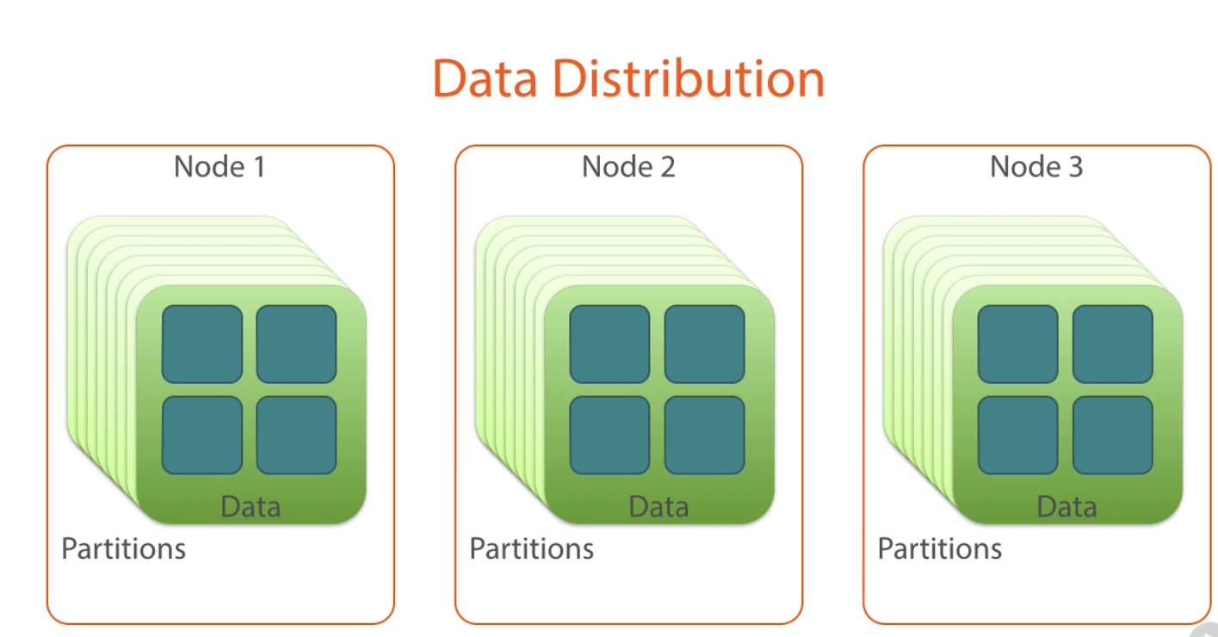

Slide 17
Data Partitioning
Partitions are memory segments that can contain hundreds or thousands of data entries each, depending on the memory capacity of your system.
Each Hazelcast partition can have multiple replicas, which are distributed among the cluster members.
One of the replicas becomes the primary and other replicas are called backups. Cluster member which owns primary replica of a partition is called partition owner.
When you read or write a particular data entry, you transparently talk to the owner of the partition that contains the data entry.
By default, Hazelcast offers 271 partitions. When you start a cluster with a single member, it owns all of 271 partitions (i.e., it keeps primary replicas for 271 partitions).
When you start a cluster with three member, one member own 271/3 partitions

Slide 18
How the Data is Partitioned
Hazelcast distributes data entries into the partitions using a hashing algorithm. Given an object key (for example, for a map) or an object name (for example, for a topic or list):
the key or name is serialized (converted into a byte array),
this byte array is hashed, and
the result of the hash is mod by the number of partitions.
The result of this modulo - MOD(hash result, partition count) - is the partition in which the data will be stored, that is the partition ID. For ALL members you have in your cluster, the partition ID for a given key will always be the same.

Slide 19
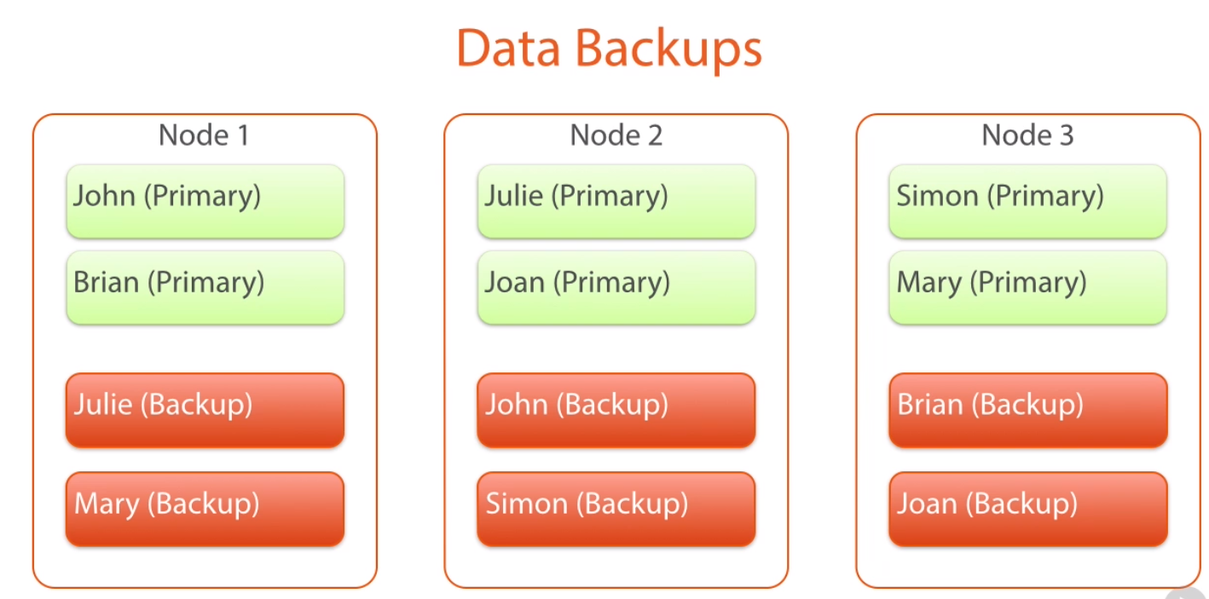

Slide 20
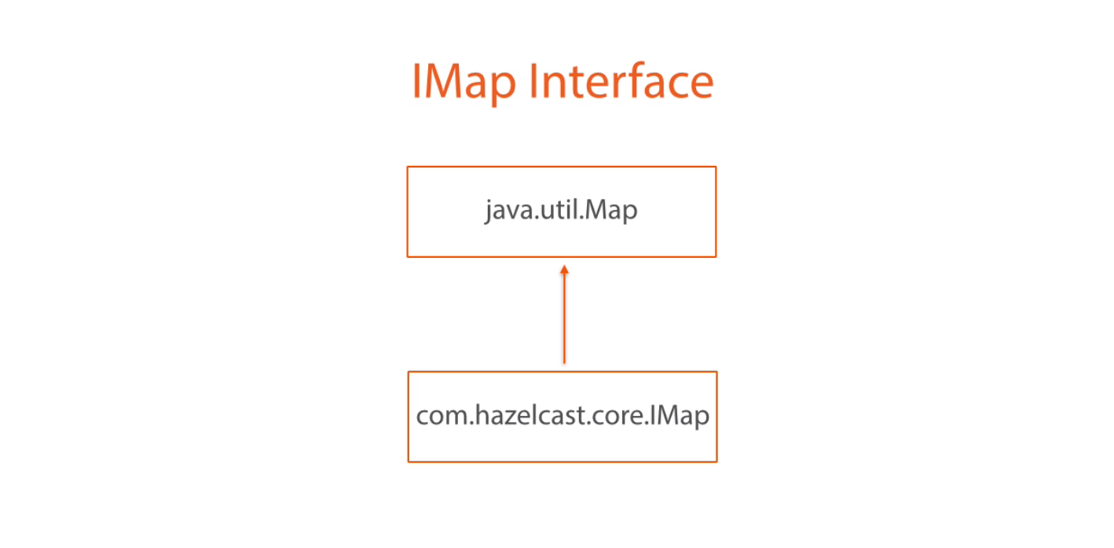
com.hazelcast.core.IMap is distributed version of java.util.Map

Slide 21
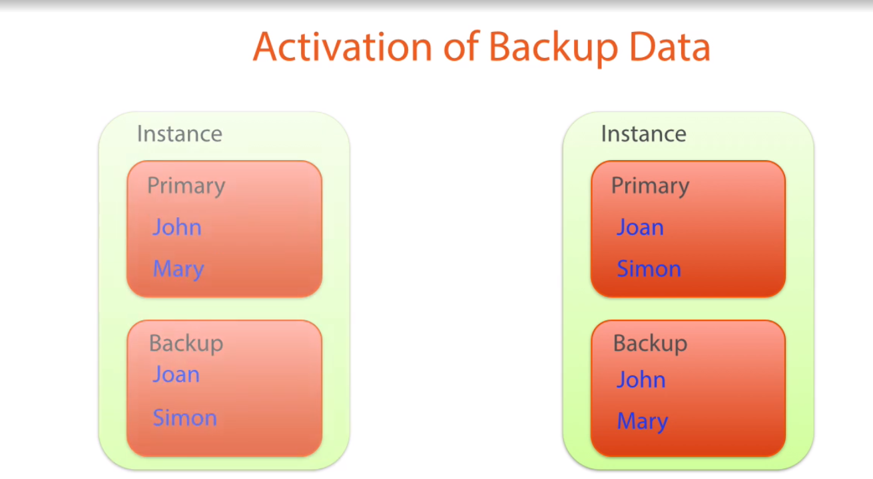
Resiliency…… the capacity to recover quickly from difficulties.

Slide 22
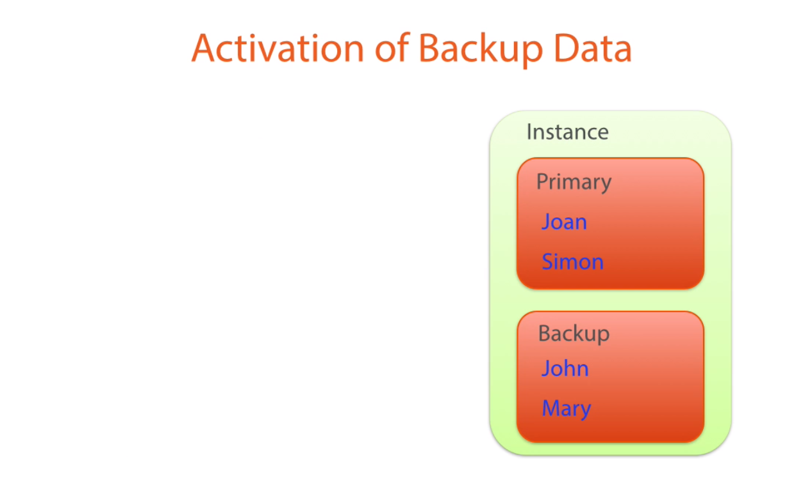

Slide 23


Slide 24
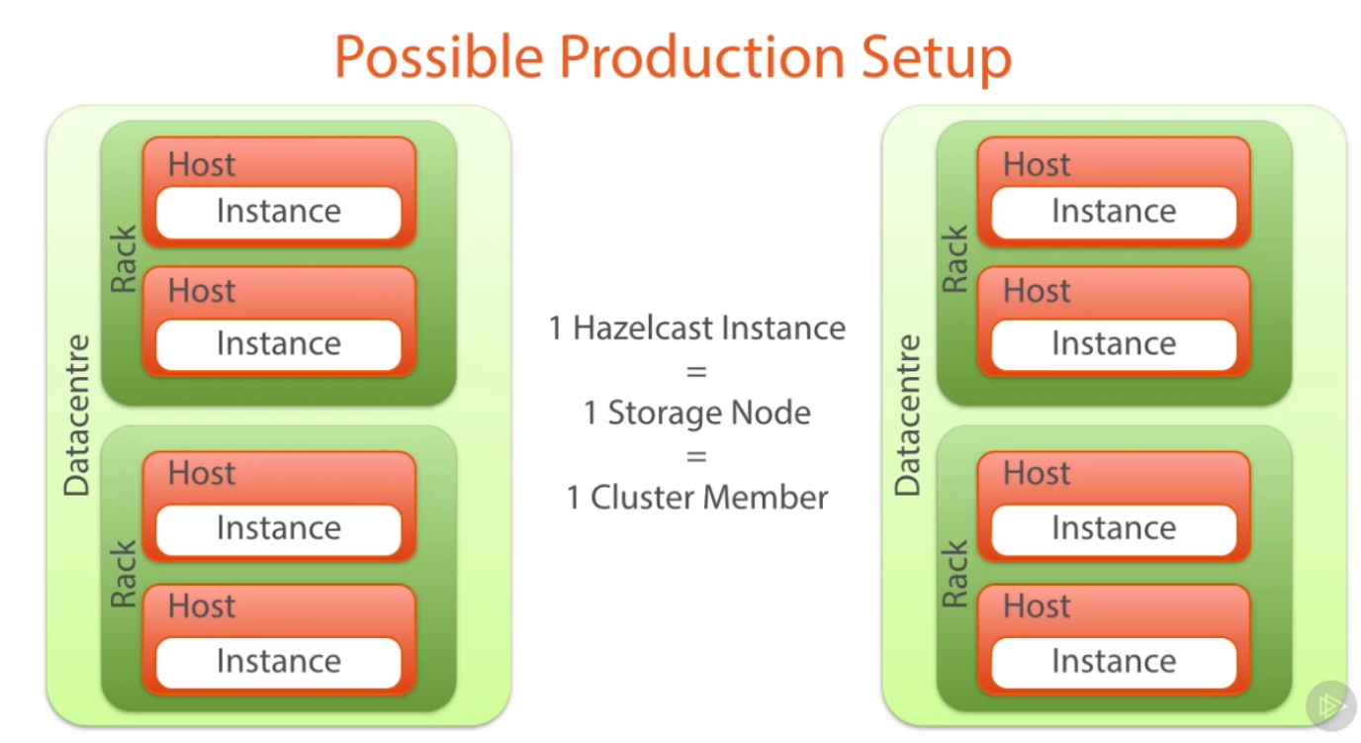

Slide 25
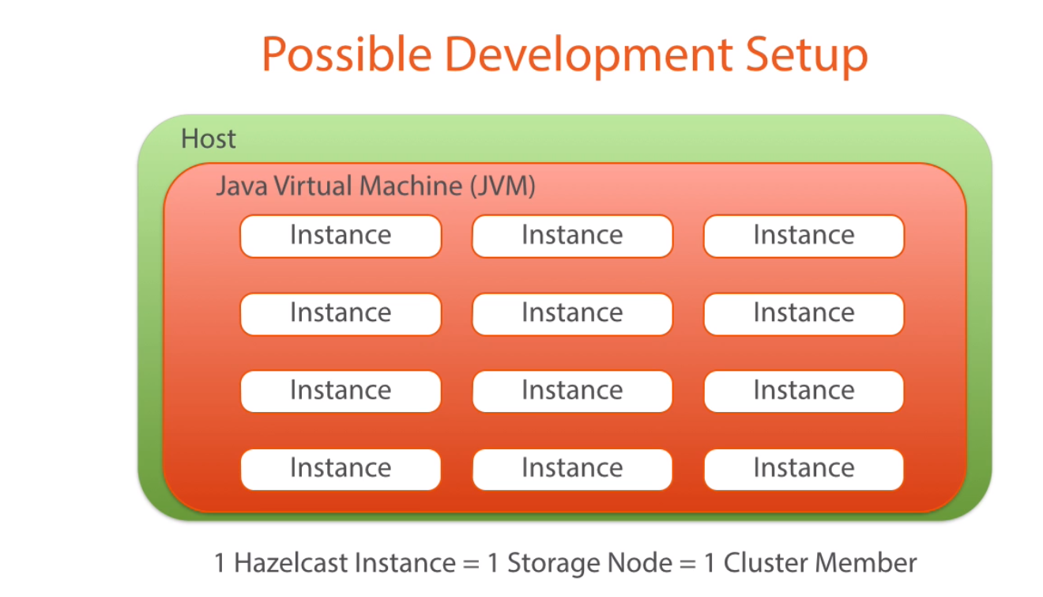

Slide 26
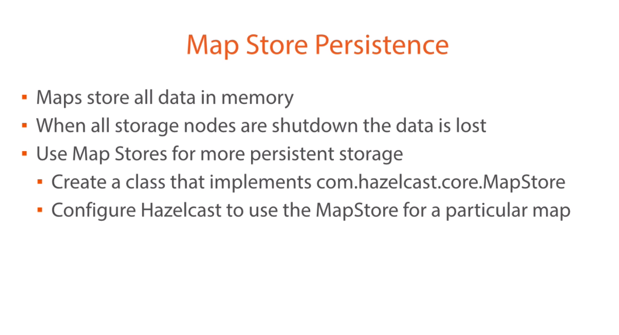

Slide 27
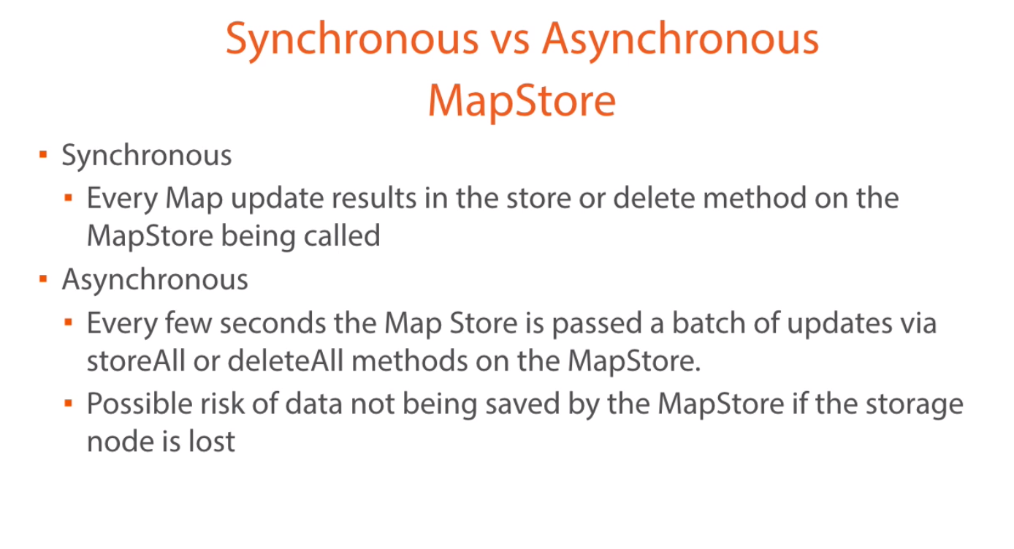

Slide 28
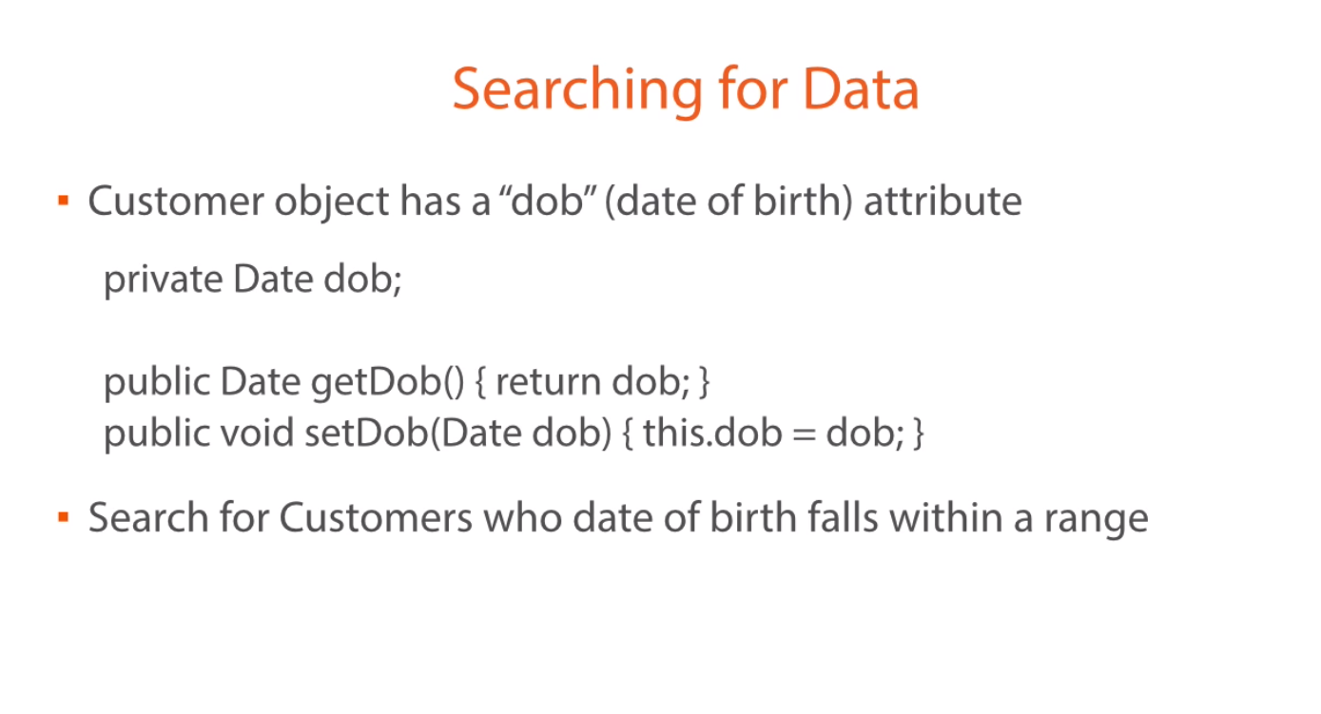

Slide 29
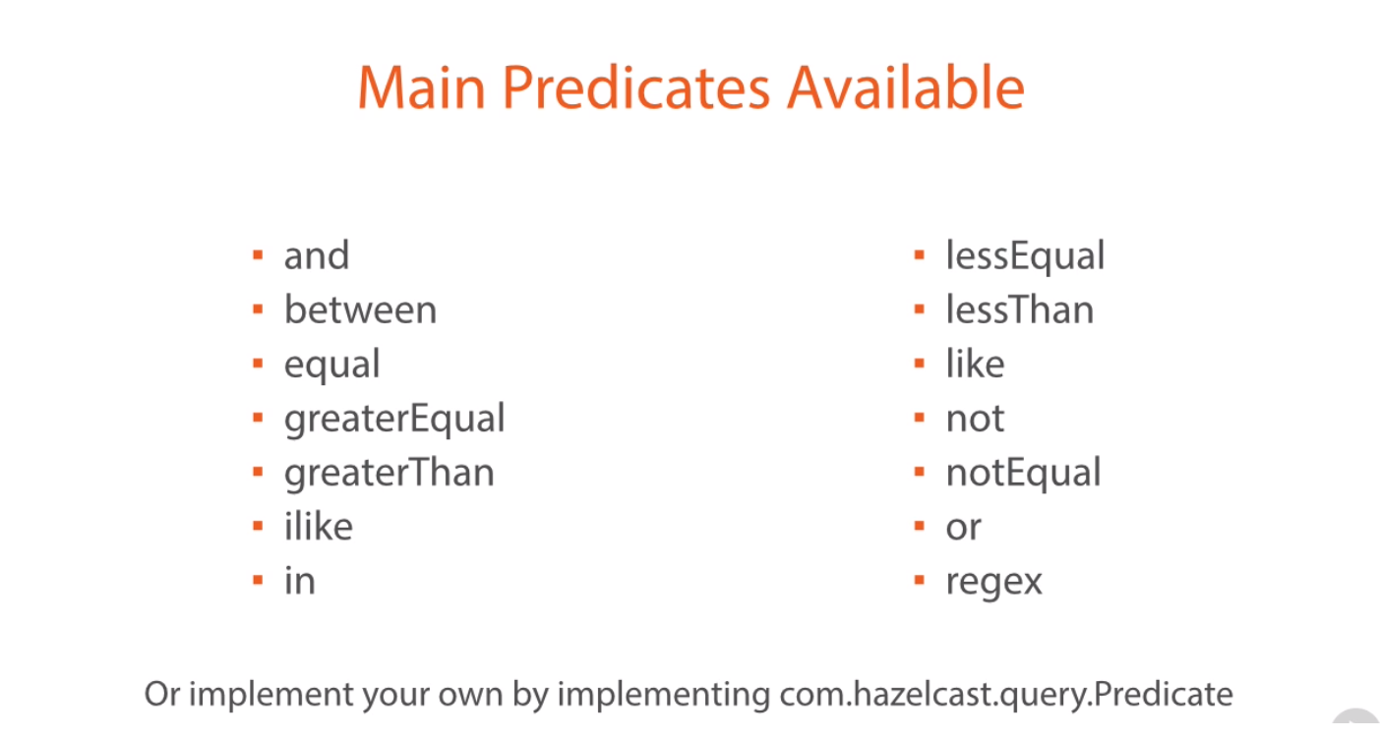

Slide 30
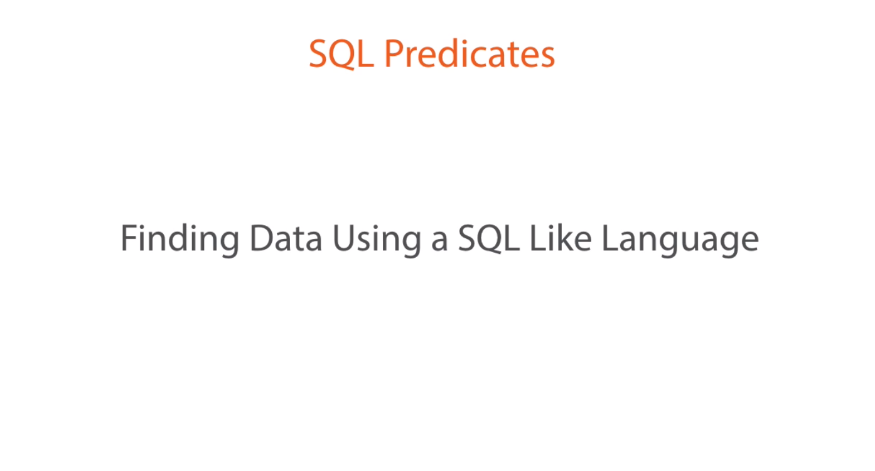

Slide 31
Sql Predicates
Possible to write queries in a SQL like language
name=‘Shahid’
name!=‘Shahid’
email not like ‘%mymail.com’
transactionAmount >= 10,000 and transactionAmount<20,000
country in (‘USA’,’IN’)
currency not in (‘AUD’,’USD’)
transactionAmount between (10000, 20000)

Slide 32
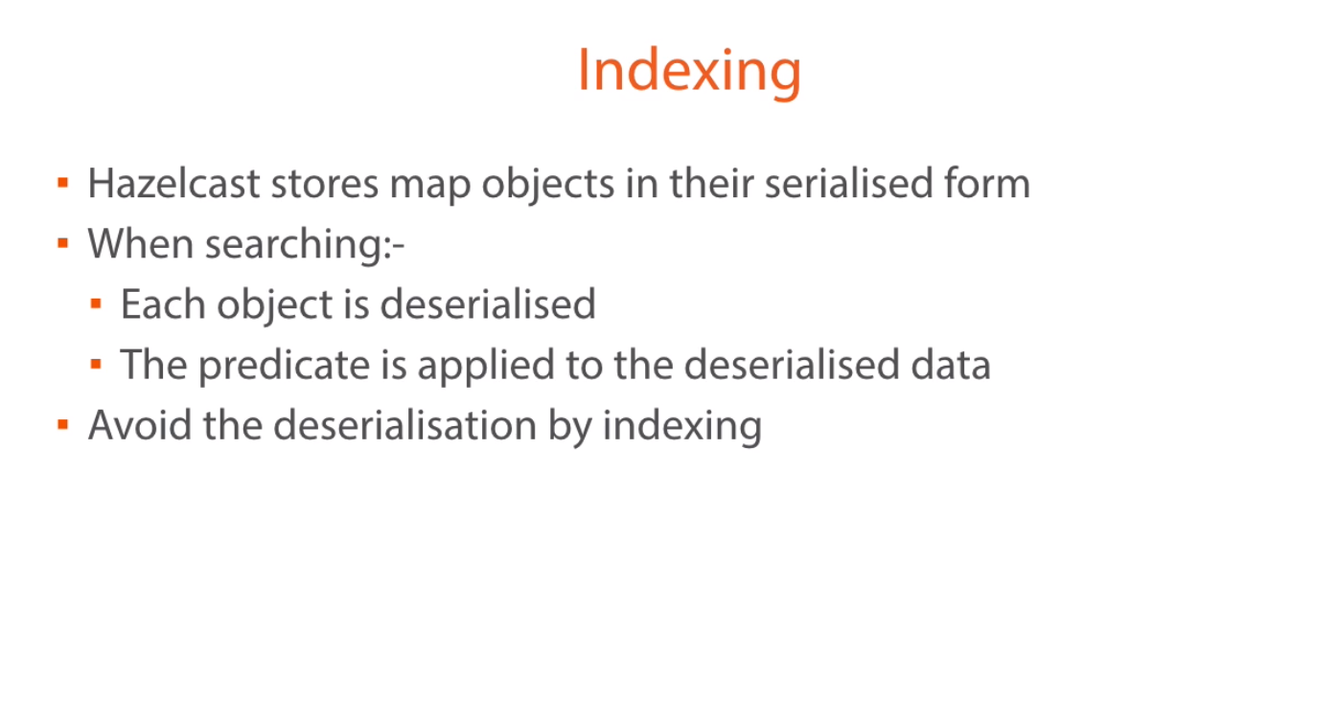

Slide 33
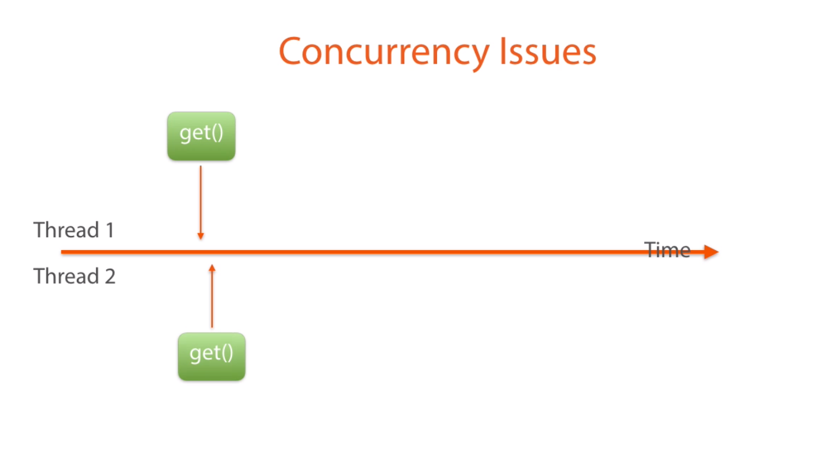

Slide 34
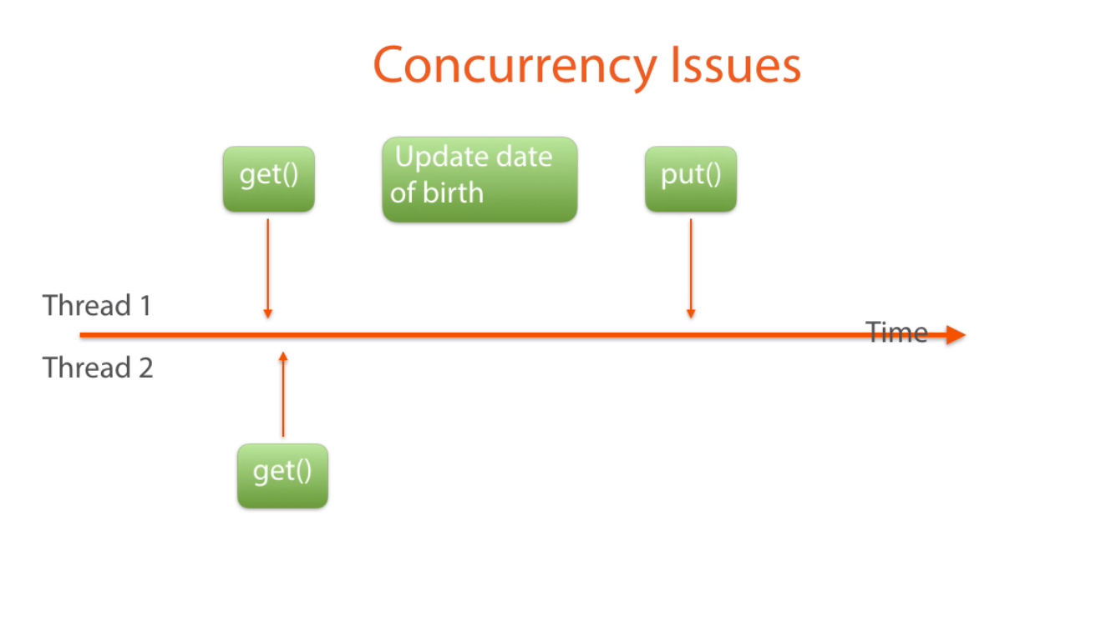

Slide 35
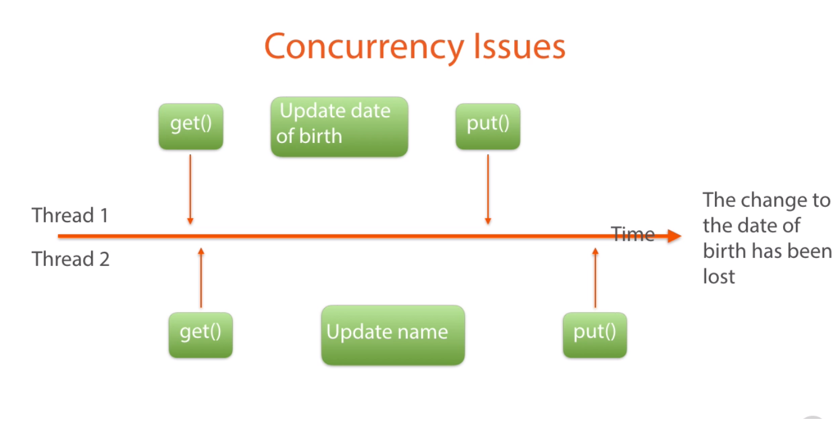

Slide 36
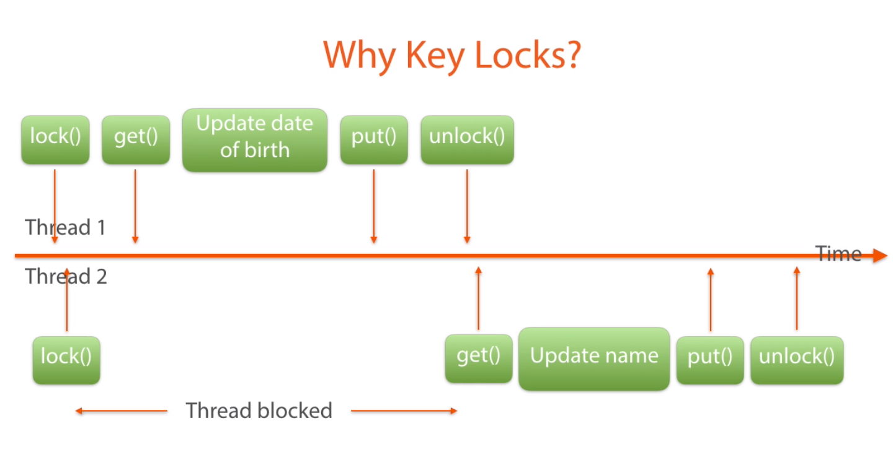

Slide 37
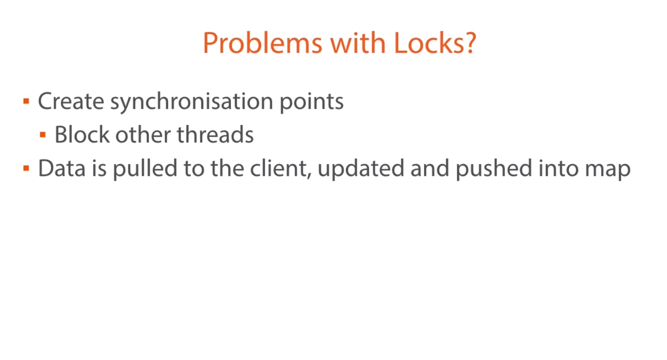

Slide 38
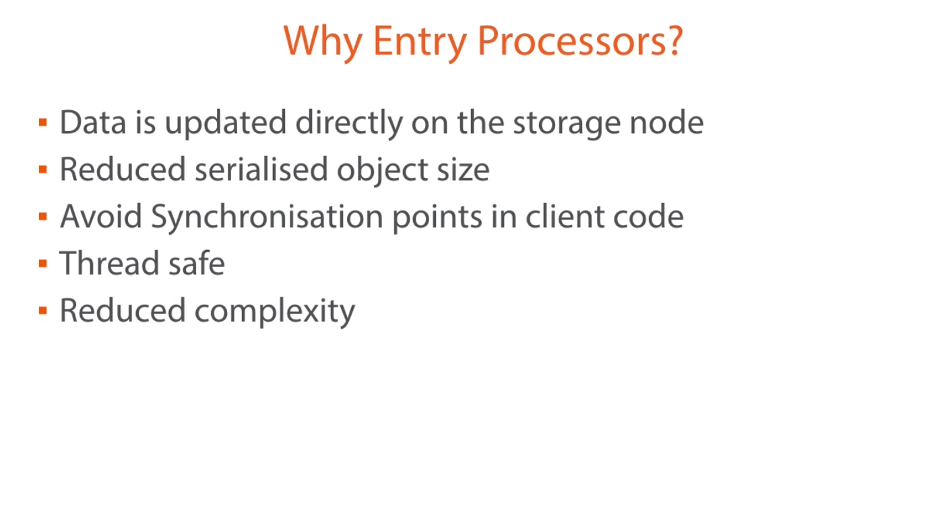

Slide 39
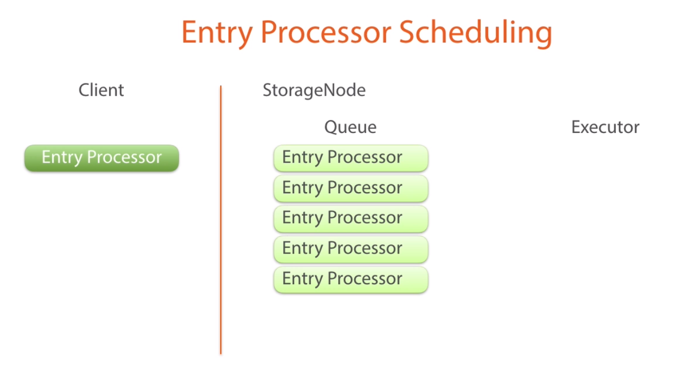
Hazelcast effectively maintain queue of entry processor for key

Slide 40
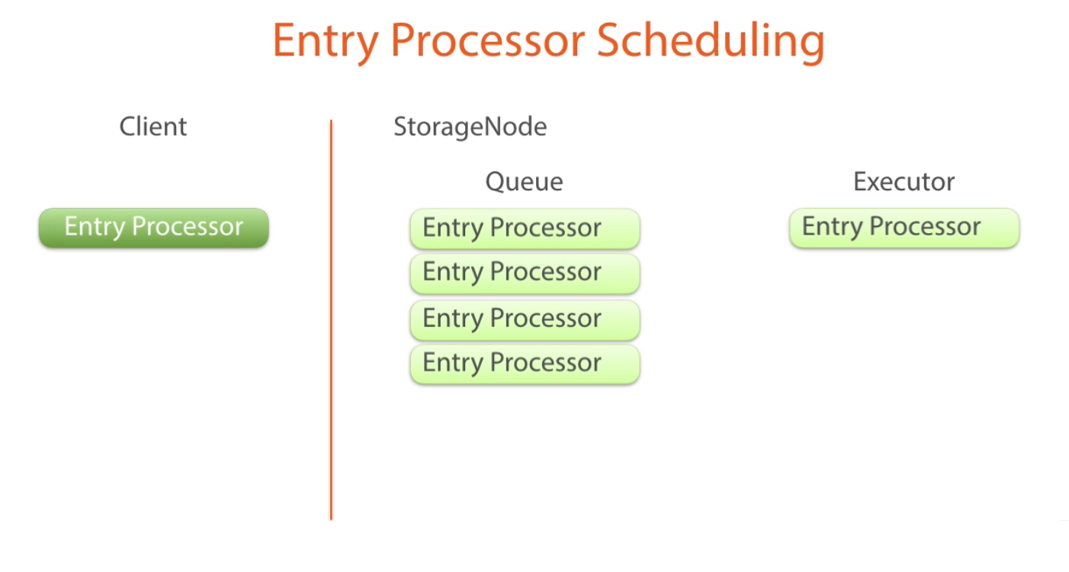
At a time one entry processor run per key.

Slide 41
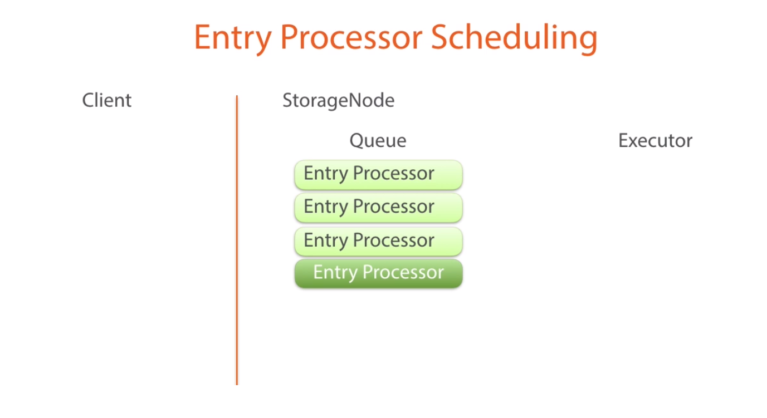
End of queue for same key

Slide 42
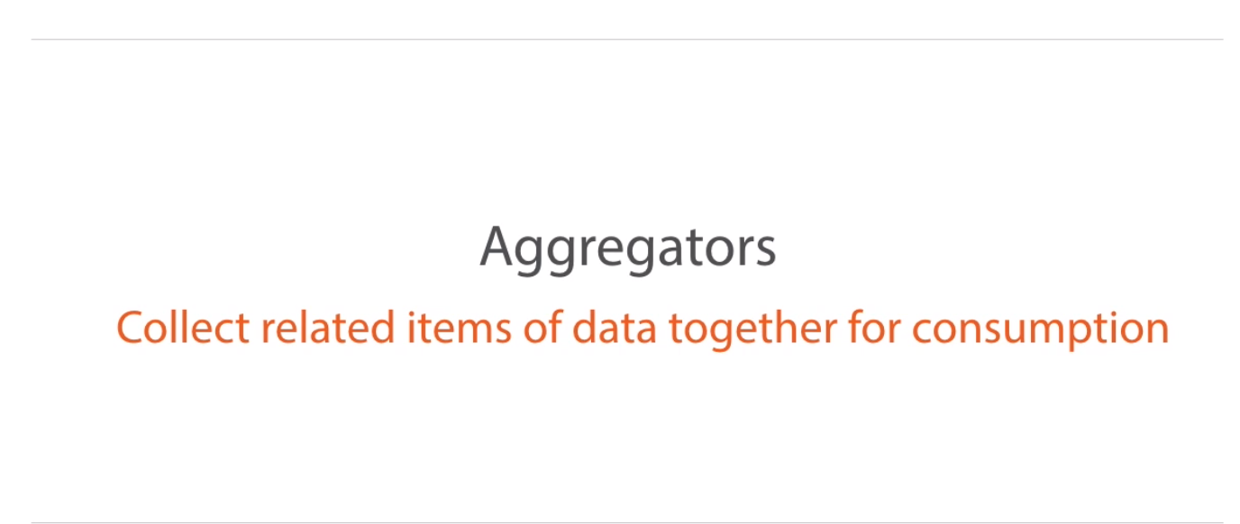

Slide 43
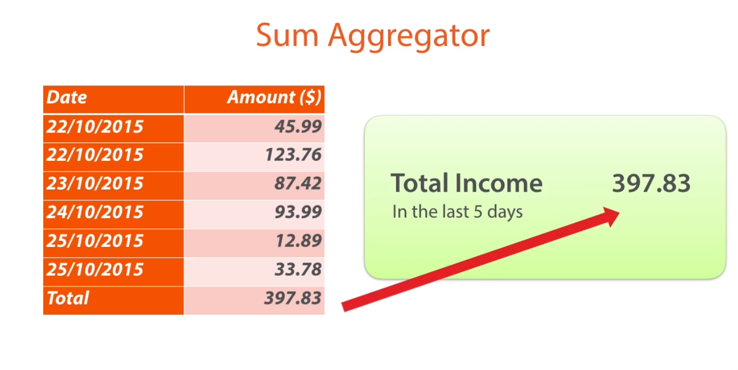

Slide 44
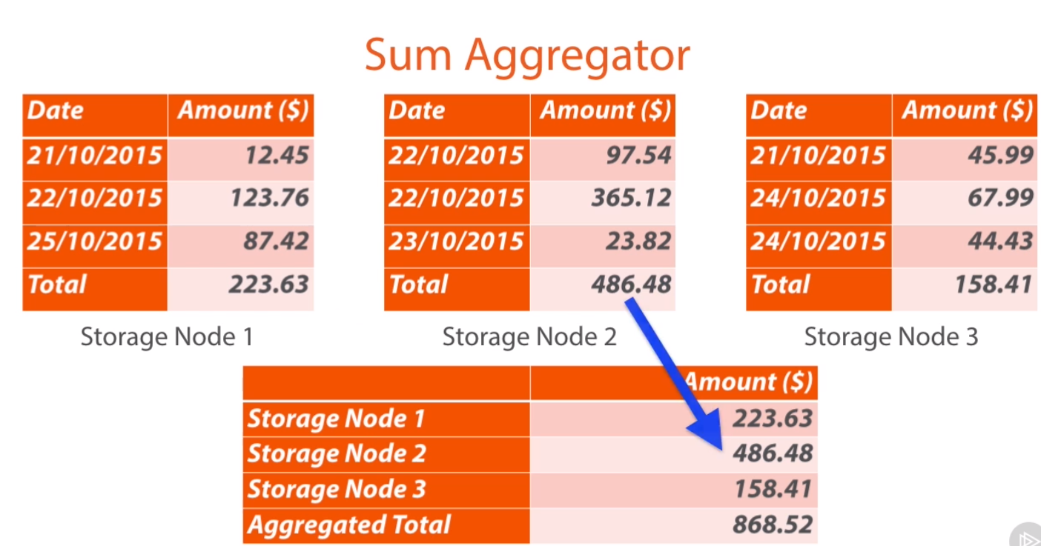

Slide 45
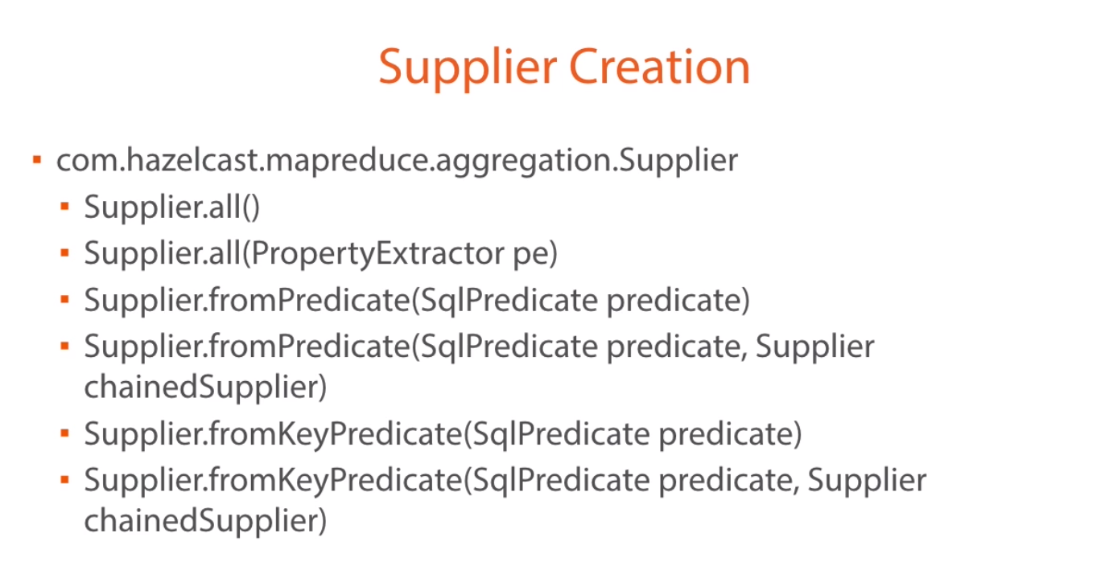

Slide 46
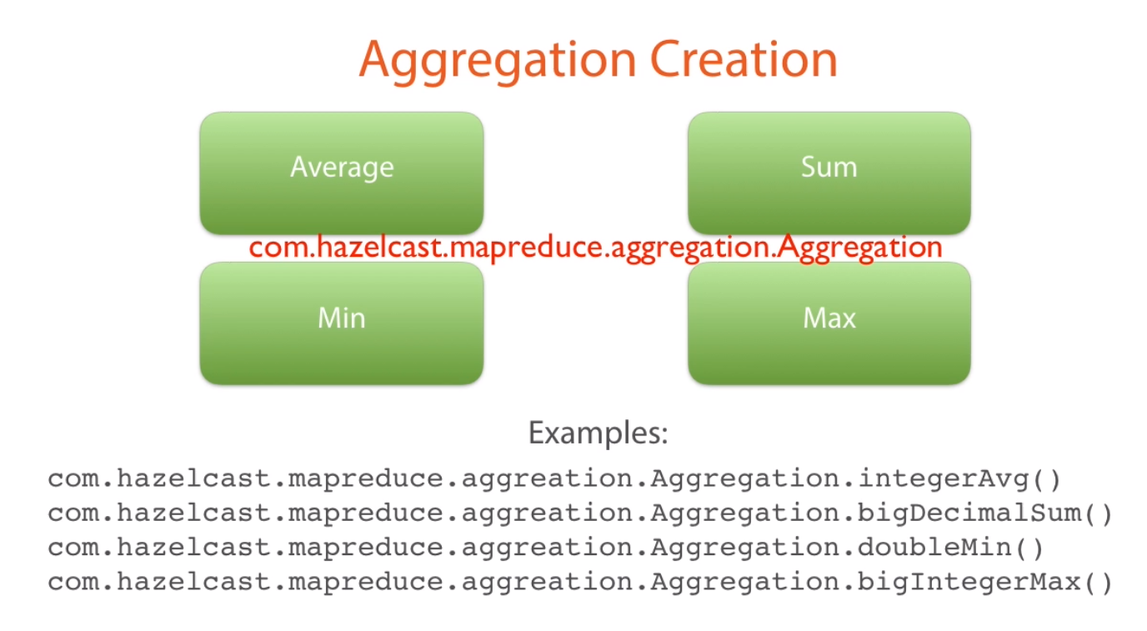

Slide 47
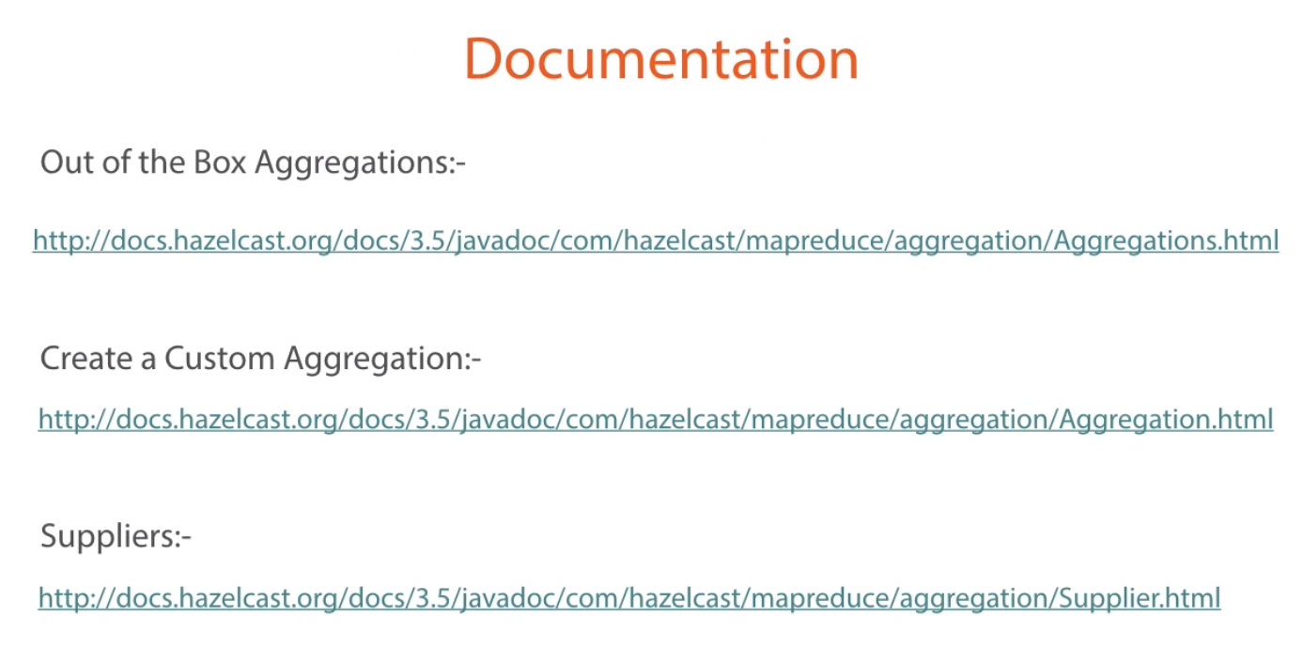

Slide 48
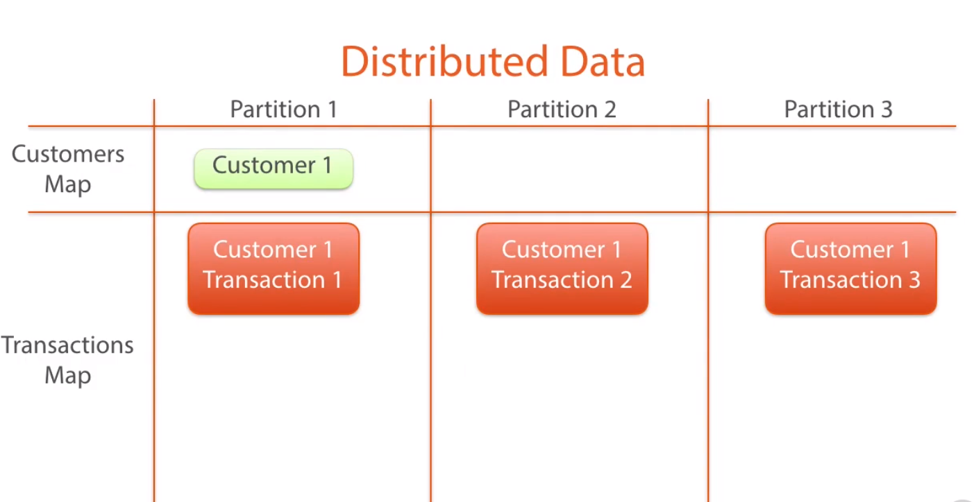

Slide 49
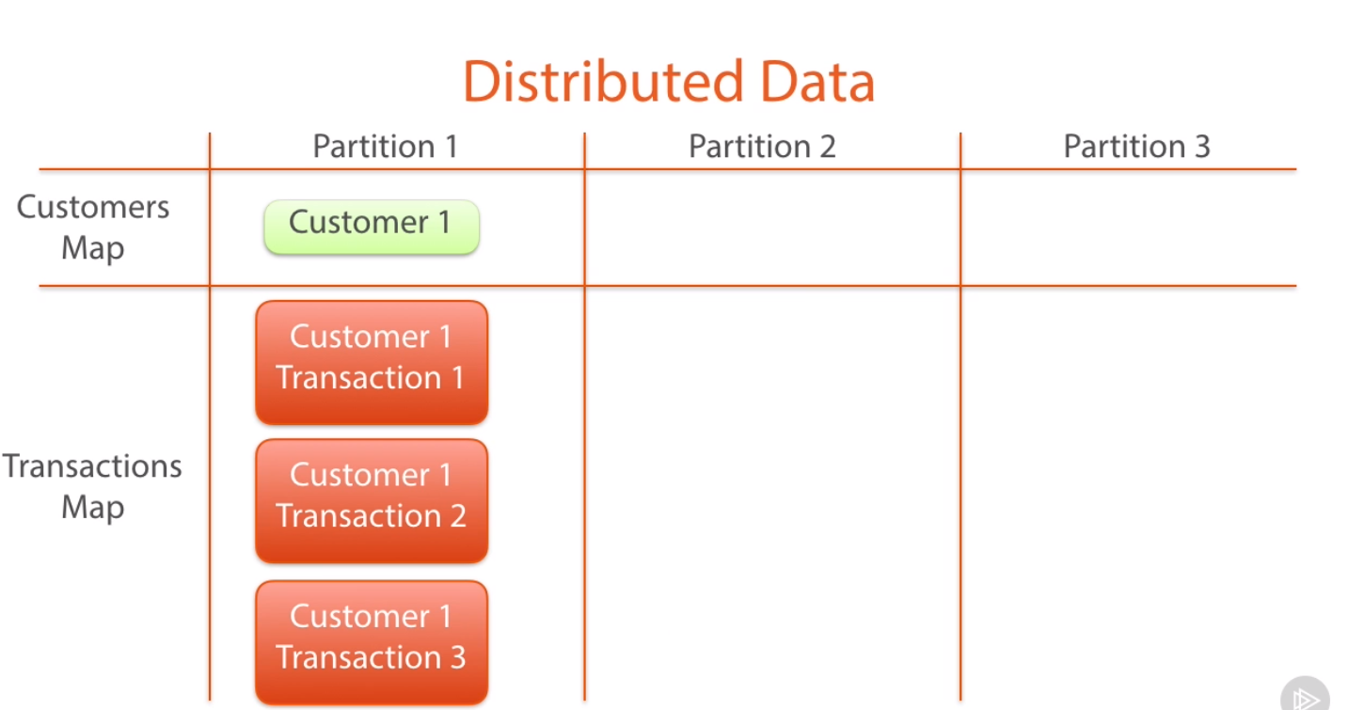

Slide 50
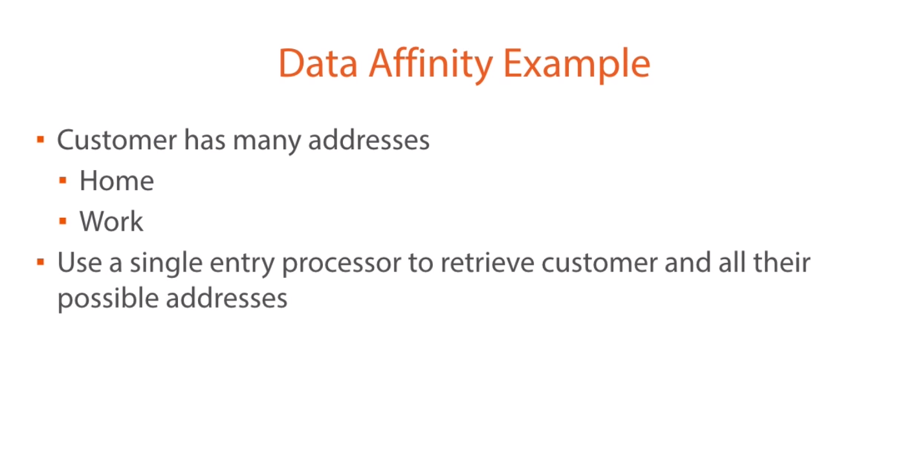

Slide 51
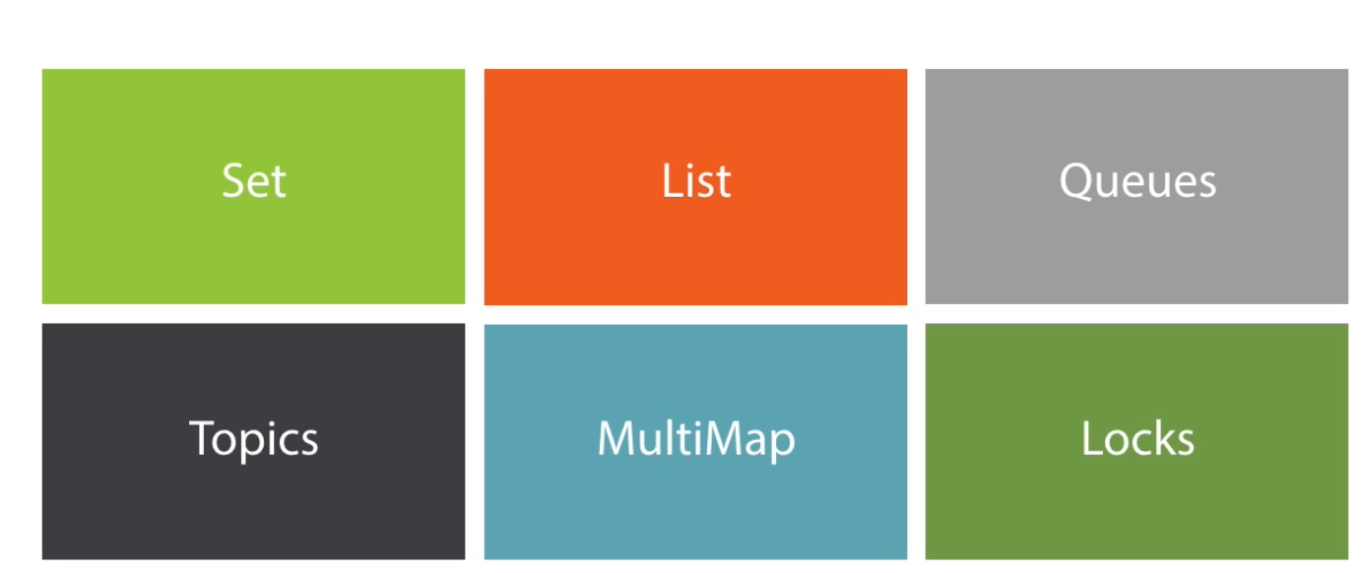
We can create our custom data structure

Slide 52
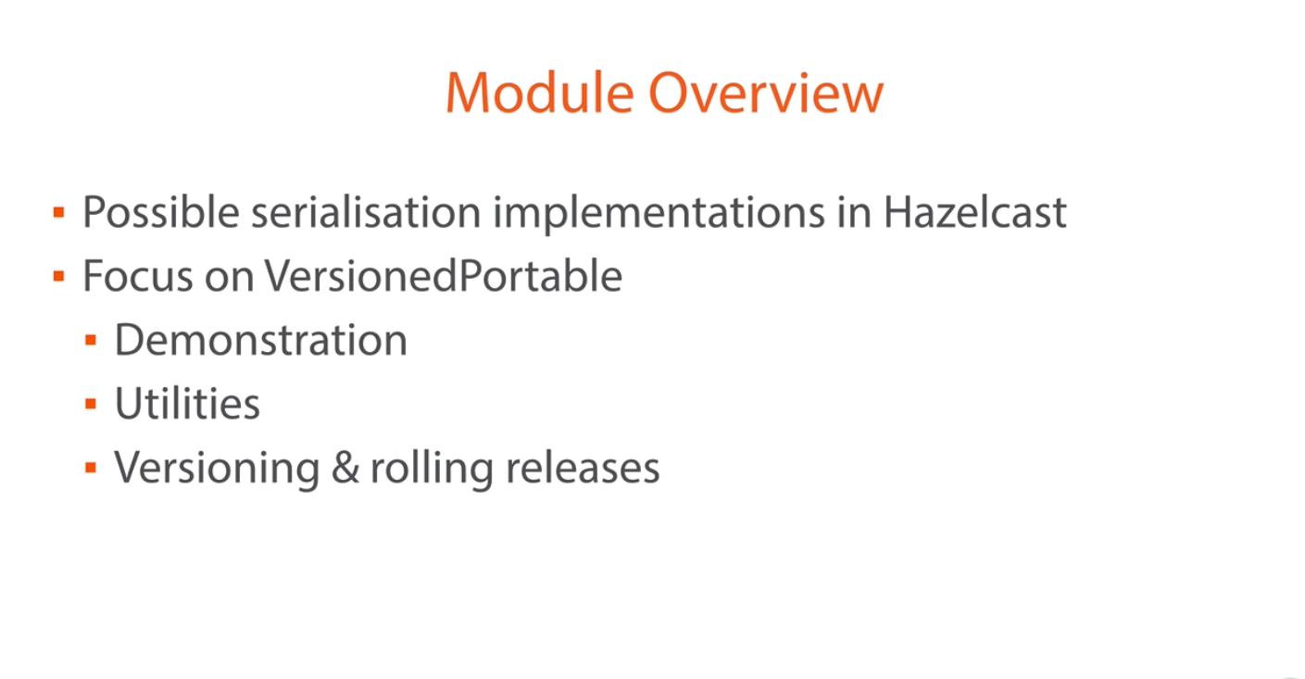
Efficient use of Network

Slide 53
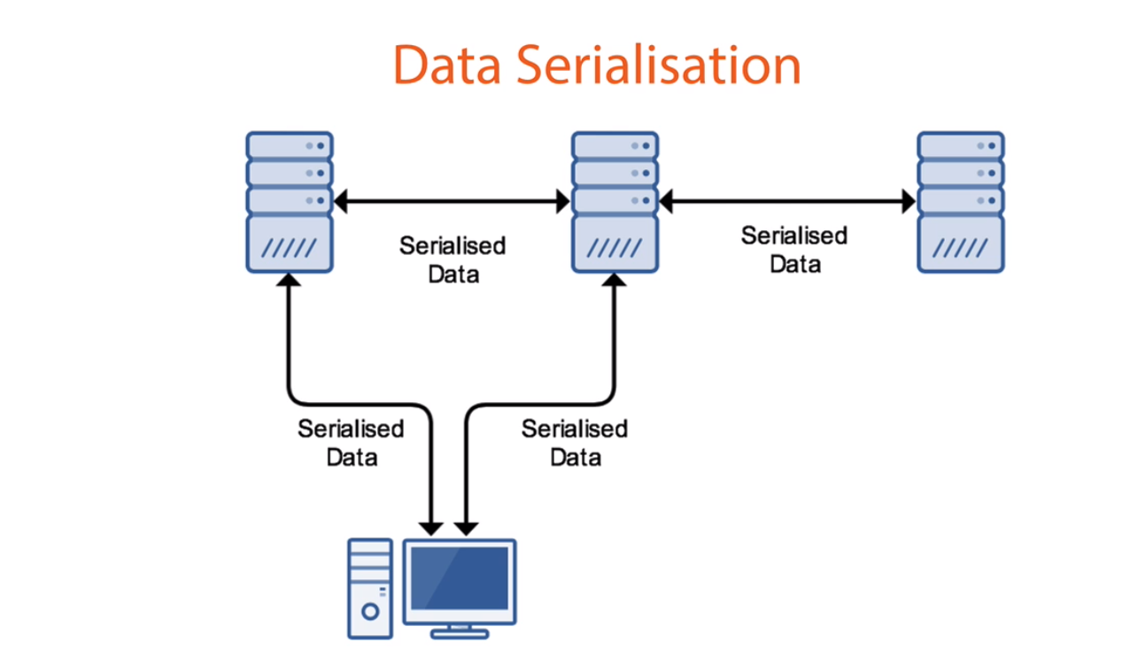

Slide 54
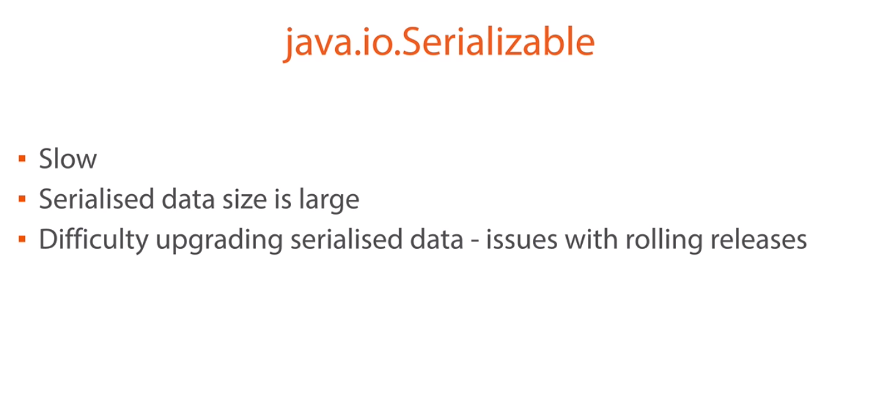

Slide 55
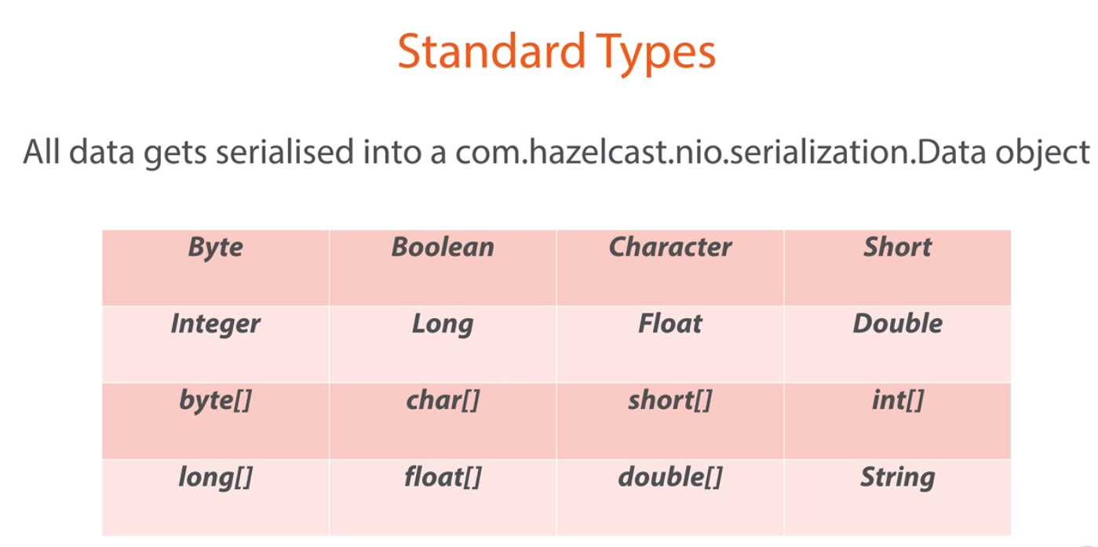

Slide 56
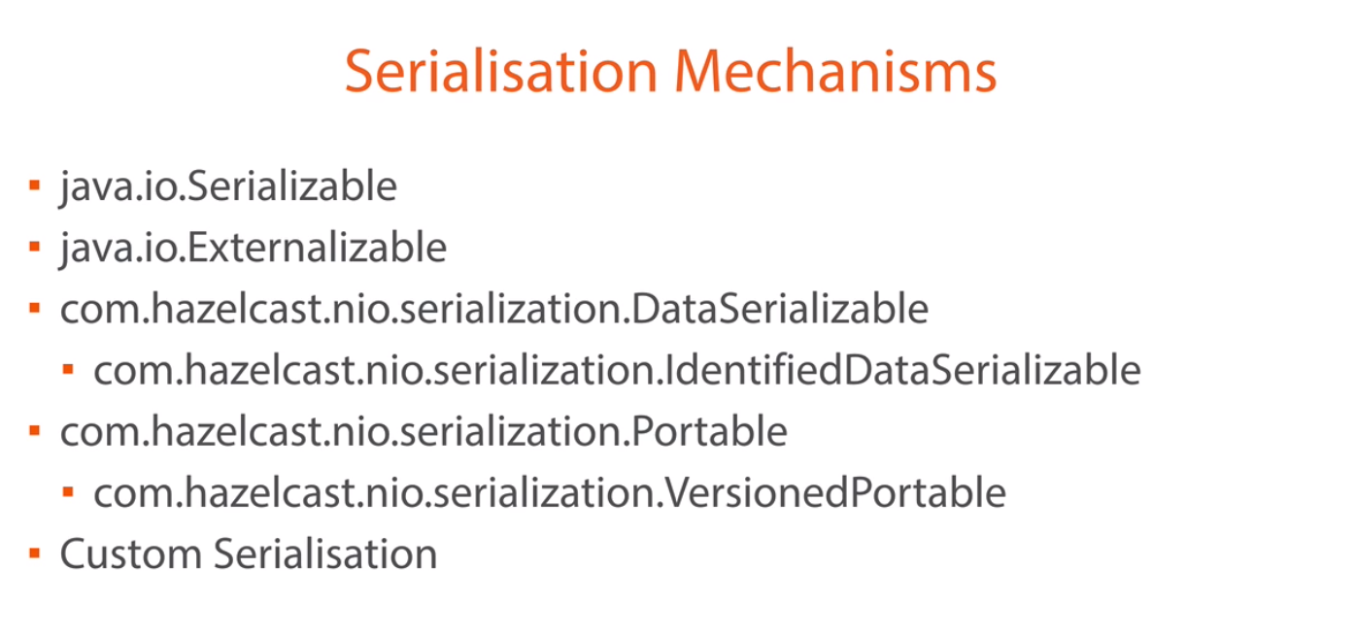

Slide 57


Slide 58


Slide 59


Slide 60


Slide 61


Slide 62


Slide 63


Slide 64


Slide 65


Slide 66


Slide 67


Slide 68


Slide 69


Slide 70


